Slide 1

Town Defenders Strategy Game prepared by: Osama N. Abu-Omar Hakam Risheh submitted to: Dr. Luai Malhis Dr. Ashraf Armoush Dr. Samer Arandi

Slide 2
Introduction
Idea: A Strategic Tactics 2.5D Game initially for the PC environment.
Played against Computer or over a network
Tactics games are very popular these days
Very enjoyable, gives a sense of achievement.
Players often get addicted to these games.
Played on PCs using mouse and Keyboard input

Slide 3
XNA 4.0 Framework
Made by Microsoft, to develop games for PC, Xbox, and WP7 devices
Easy to learn and use, for Windows PCs
Writing games with C#/XNA4.0 is less time consuming
Put previous experiences of .NET framework to use
More levels of customization required, tile engine, frame animations, UI…etc

Slide 4
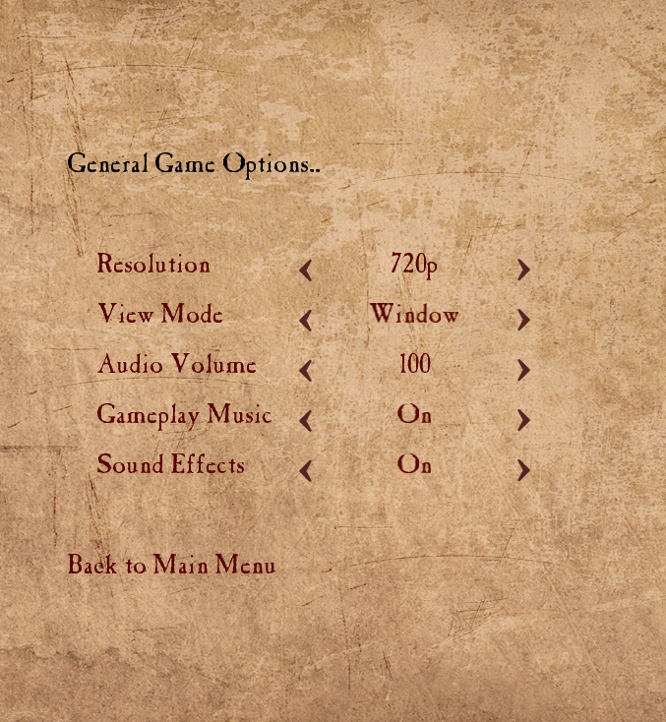
Game Screen UI
Start with the UI system
Develop customized UI Controls from scratch
Links, Switches, Buttons, Labels, Menus …etc

Slide 5
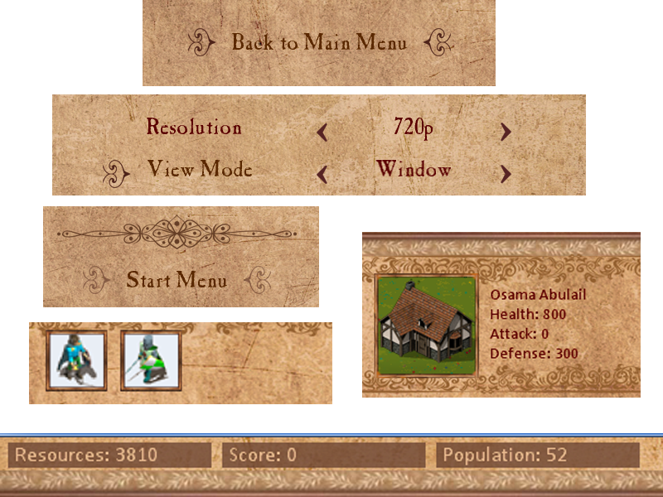
Customized Controls

Slide 6
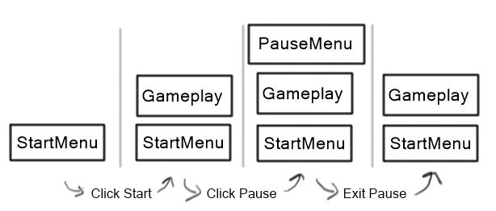
The GameStateManager
Push, pop states like:
Title screen
Menu screen
Play screen …etc
Uses a stacking structure to draw states
+ability to go back to previous states

Slide 7
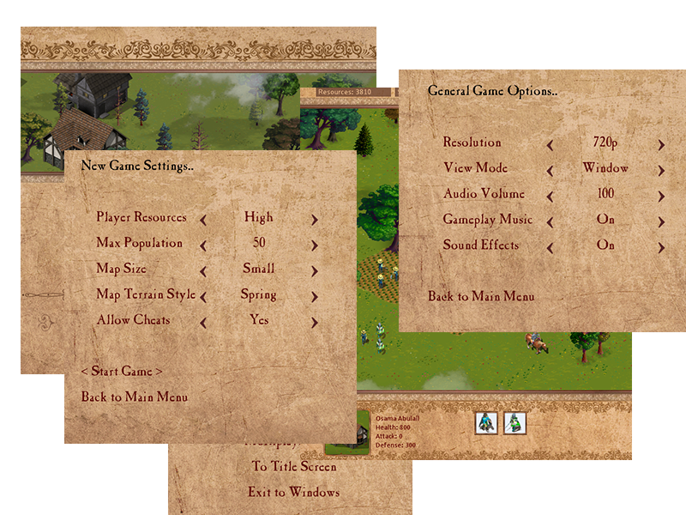
Game screens

Slide 8
Asset Loader
Ensures to load all required assets at runtime
Assets of kinds:
Textures – including sprite sheets
Soundtracks
SoundEffects
Fonts

Slide 9
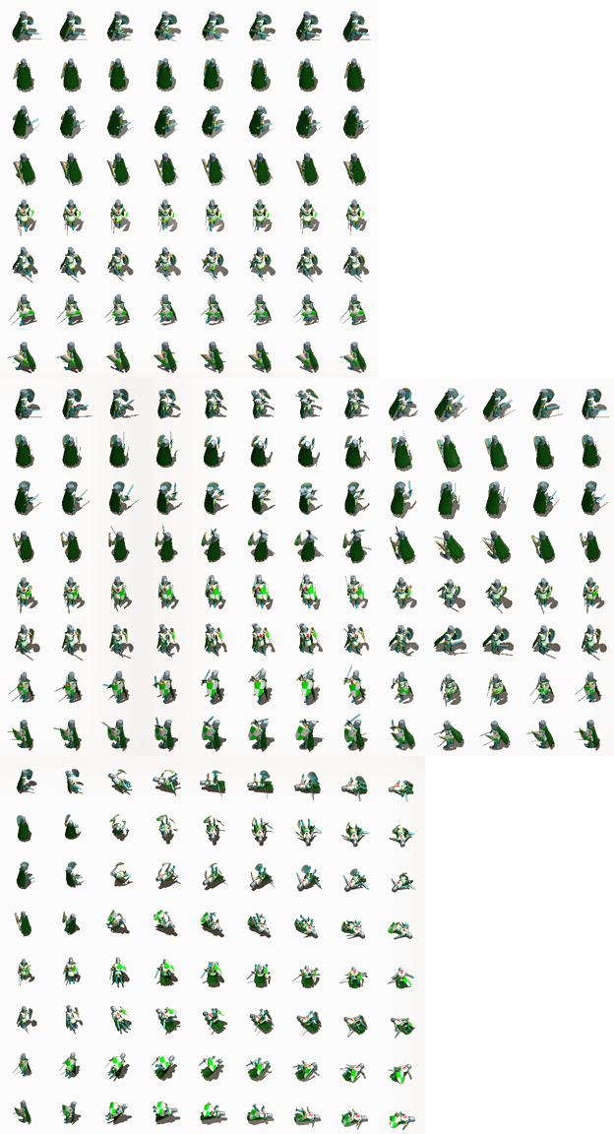
Animations
SpriteAnimation Type defines all animation behaviors.
Sample sprite sheet, frame animation
loop on a frame line depending on the visual state.

Slide 10
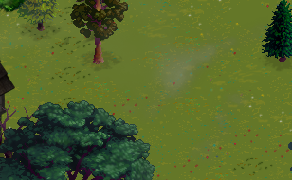
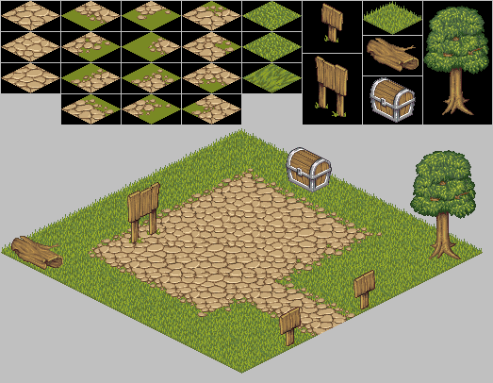
The Tile Engine
The map is isometric
(2.5D). 3D look from one fixed viewing location
A tile map composed of map cells.
Each has drawDepth, and location
And a stack of tile textures

Slide 11
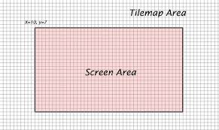
Tile Map Camera
Treated just like 2D games
Simply, A viewport rectangle
Location changes on keys (A,W,S,D)
Optimization: draw only objects in the Screen area

Slide 12
Collisions
Collisions are detected with the help of the tile engine.
Some cells/tiles are walkable and others are not
Fog of war: units register surrounding tiles as seen.
If enemies are registered for the same tile
Collision Detected - attack

Slide 13
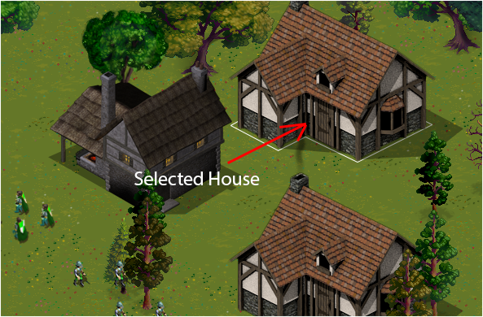
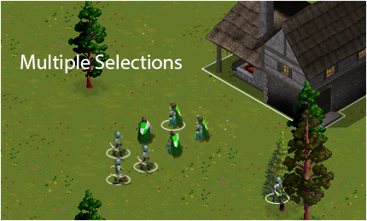
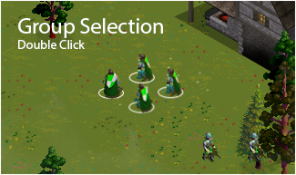
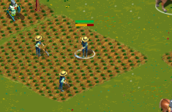
Selection Handling
Implemented as a selection capability.
Mouse actions + Ctrl interaction.
Supporting multiple selection of units.
Group selection (double click)

Slide 14
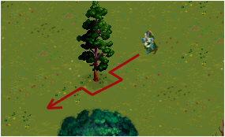
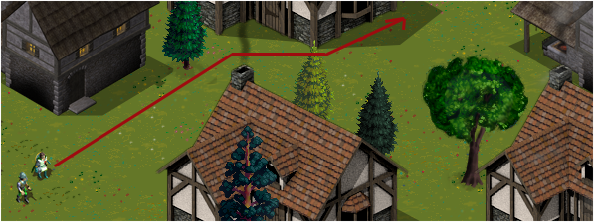
Unit Movement
Used AI algorithms
The A* (A star)
Makes paths by bypassing not-walkable tiles on the tile map

Slide 15
AI Activities
All units are controlled by the player
But: units can also decide for themselves
Examples:
Enemy soldier on sight – attack
Stronger opponent – retrieve to town
Workers carry resources to storage, and go back

Slide 16
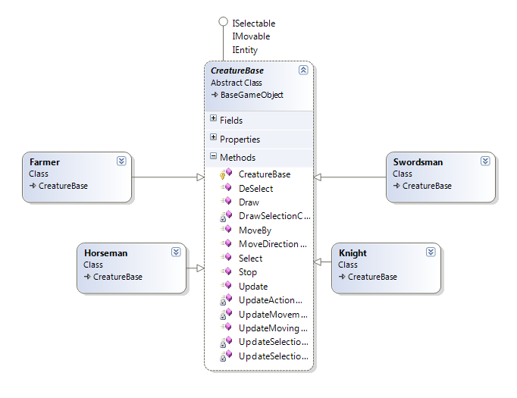
Components - Creatures

Slide 17
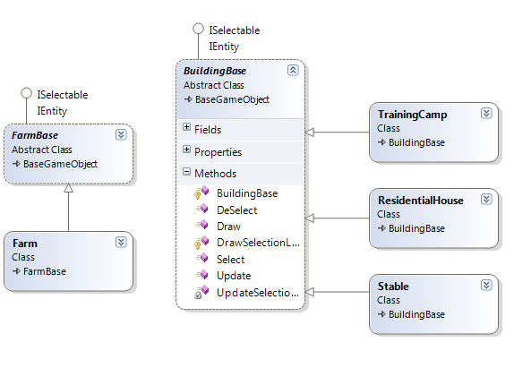
Components - Buildings

Slide 18
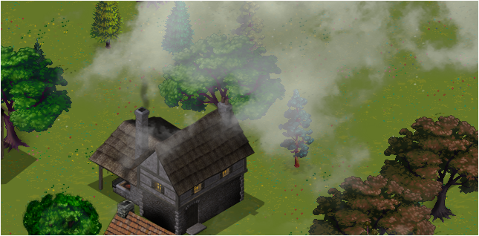

Cloud Manager
Clouds floating on the sky (effect)
Manager creates random pool of cloud objects
Performance and resource wise: specified quantity is constant.

Slide 19
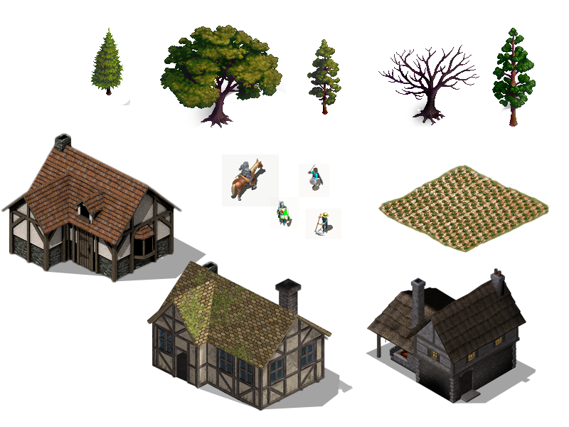
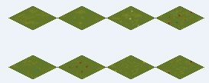
Visuals

Slide 20
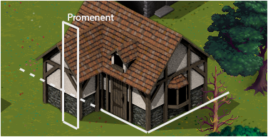
Drawing large objects
Issue: draw 2D to appear like 3D
on buildings, trees …etc
came up with the slicing algorithm.
The object is divided into segments, each with its own depth depending on the location.

Slide 21

Mouse input
Issue: Getting mouse as a map location
Calculated from camera position, and screen location.
With a MouseMap, define what exact tile is acted on.

Slide 22
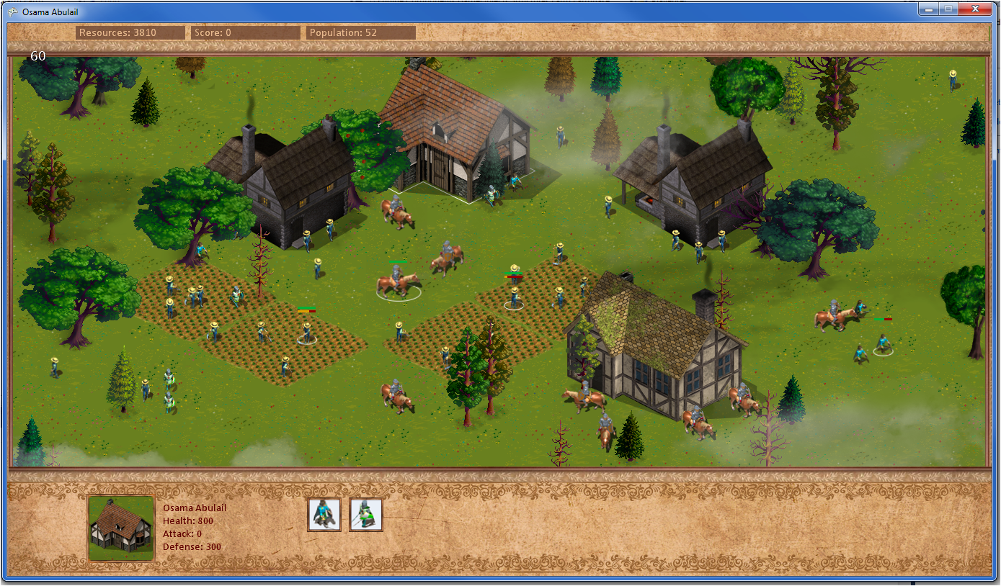
Gameplay

Slide 23
Networking
The game should support for multiple players on a Local Area Network.
Need to build a custom protocol, challenging part
Every player has up to 200 isolated units
Units are controlled from both (AI, User)
Problem: max population is 200 units, sync all (locations, visual states, future acts) to all players.
All players have the same view of the map
200*<stateData>*<Players>*30fps / second
Sent to server And synced to all players

Slide 24
Problem faced
Unfortunately, the networking protocol is not complete at the moment
Time Shortage: this stage needs more time than the time planned at the beginning of the project.

Slide 25
Thank You
Questions?

